Slide 1


Efficient and Robust Automated Machine Learning
IE 506: Machine Learning: Principles and Techniques
Machine Trainers
Saimadhav S ( 24M1532 ) , M.Tech IEOR
Trivikram Umanath ( 24M1535 ) , M.Tech IEOR

Slide 2
OUTLINE
S.No | Topic | Slide No.
 | Problem Statement | 6
2. | Stage 1 Work | 10
3. | Comments | 11
4. | Addressal of Comments | 12
5. | Final Review Work | 15
6. | Novelty | 22
7. | Contribution | 23
8 | Conclusion | 24
9 | Future Directions | 25

Slide 3
Combined Algorithm Selection and Hyperparameter Optimization (CASH):
Problem Statement
A = {A⁽¹⁾, . . . , A^{(R)}} - Set of algorithms
Λ^{(j)} - domain of hyperparameters of each algorithm A^{(j)}
D_{train}: {(x₁, y₁), . . . ,(x_{n}, y_{n})} - training set
{D⁽¹⁾ _{valid}, . . . , D^{(K)} _{valid}} - D_{train} split into K cross-validation folds
{D⁽¹⁾ _{train}, . . . , D^{(K)} _{train}} such that D^{(i)} _{train} = D_{train} \ D^{(i)}_{valid} for i = 1, . . . , K.
𝓛(𝓐_{λ}^{(j)} , 𝓓_{train}^{(i)}, 𝓓_{valid}^{(i)}) loss that algorithm A^{(j)} achieves on D^{(i)}_{valid} when trained on D^{(i)}_{train} with hyperparameters λ.
A*, λ* ∈ argmin _{A(j)∈A,λ∈Λ(j)} 1/K (Σ 𝓛(𝓐_{λ}^{(j)} , 𝓓_{train}^{(i)}, 𝓓_{valid}^{(i)}))

Slide 4
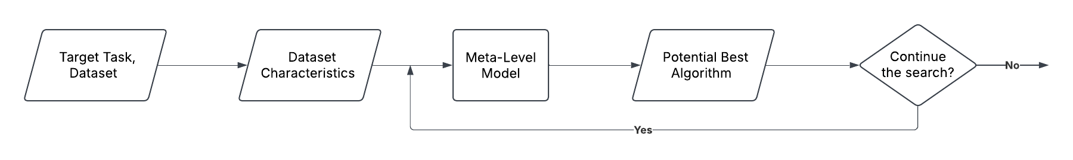
Introduction: Meta Learning
Figure 1. Flow chart of Meta learning Model [2]
Types of Meta-Level Models
Meta Level Models
Regression Models
Classification Model
Relative Performance Model
Ref: Brazdil, Pavel, Christophe Giraud Carrier, Carlos Soares, and Ricardo Vilalta. Metalearning: Applications to data mining. Springer science & business media, 2008.

Slide 5
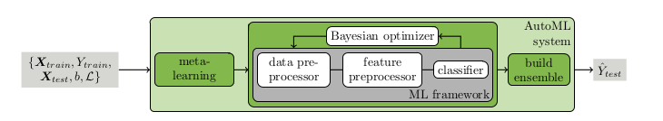
Introduction: Bayesian Optimization
What is Bayesian Optimization?
A global optimization strategy
Used when function evaluations are Expensive or Noisy
Brute-force searching
Probabilistic approach to model an objective function
Selects the most promising point for next evaluation
Why Bayesian Optimization?
🔹 Minimizes function calls 🔹 Works without gradients: 🔹 Handles noise and uncertainty. 🔹 Balances exploration & exploitation
Figure 1. Auto-Sklearn Framework [1]

Slide 6
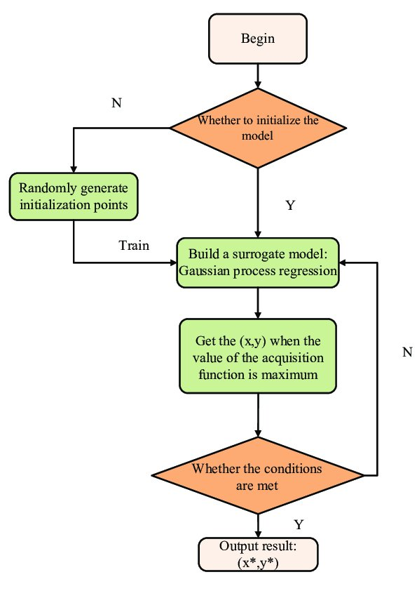
Introduction: Bayesian Optimization
1️ Surrogate Model (Approximates the Unknown Function)
The true function is expensive to evaluate, so we use an approximate model (surrogate).
The surrogate predicts function values based on past observations.
Common choices: Decision Trees, Random Forests, Bayesian Neural Networks, Polynomial Models.
2️Acquisition Function (Decides the Next Evaluation Point)
Uses the surrogate model’s predictions to determine where to sample next.
Balances exploration (searching uncertain regions) vs. exploitation (focusing on promising areas).
Common strategies: 🔹 Improvement-based methods – Focus on areas likely to improve results eg Expected Improvement 🔹 Confidence-bound methods – Explore regions with high uncertainty eg Upper Confidence Bound
Figure 2. Flow chart of Bayesian Optimization [4]

Slide 7
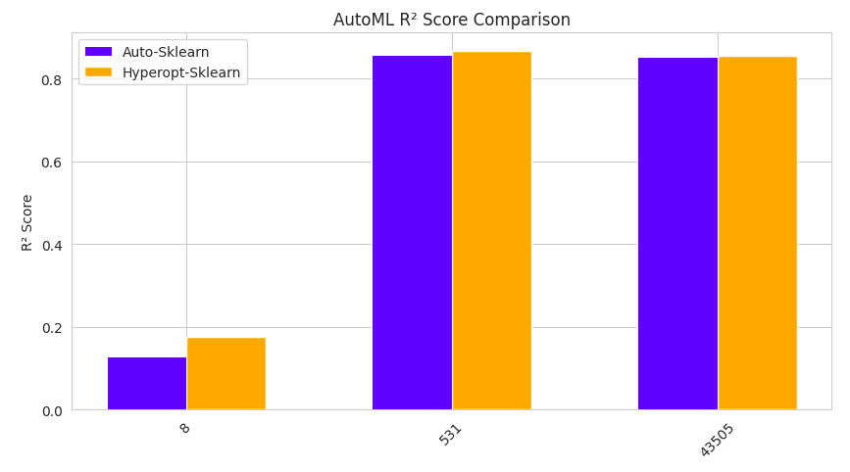
First-part work : Auto Sklearn vs Hyperopt Sklearn (Regression)
R2 Score Analysis
Performance Trends
AutoML models (Auto-Sklearn & Hyperopt-Sklearn) exhibit varying R² scores across datasets, highlighting differences in dataset complexity and model adaptability.
Dataset Analysis
531 (Boston Housing): Both models achieve high R² (~0.85-0.9), indicating suitability for regression.
43505 (Life Expectancy): Similar strong performance, suggesting well-defined patterns in the data.
8 (Liver Disorders): Low R² (~0.1-0.2), indicating difficulty in capturing the underlying patterns, likely due to noisy or complex relationships.
Model Comparison
Hyperopt-Sklearn and Auto-Sklearn perform comparably on high-performing datasets (531 & 43505).
Hyperopt-Sklearn slightly outperforms Auto-Sklearn on Dataset 8, but both models struggle, reinforcing dataset dependency.

Slide 8
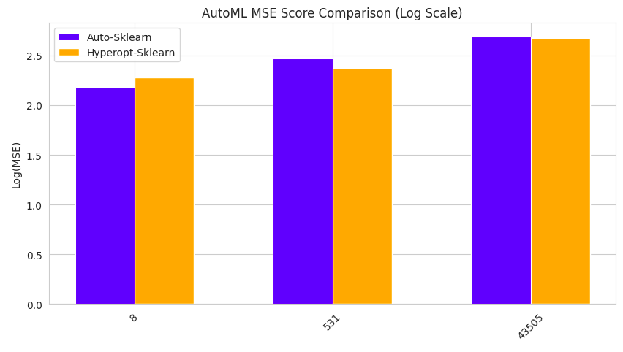
First Part Work: MSE Analysis
Performance Trends
MSE scores vary significantly across datasets, visualized in log scale, reflecting differences in prediction errors.
Dataset Analysis
531 (Boston Housing): Lower MSE, indicating better regression performance.
43505 (Life Expectancy): Highest MSE, suggesting challenges in capturing relationships.
8 (Liver Disorders): Moderate MSE, highlighting some difficulty in modeling.
Model Comparison
Hyperopt-Sklearn generally achieves lower MSE compared to Auto-Sklearn.
Both models struggle on Dataset 43505, reinforcing dataset-dependent performance variations.

Slide 9
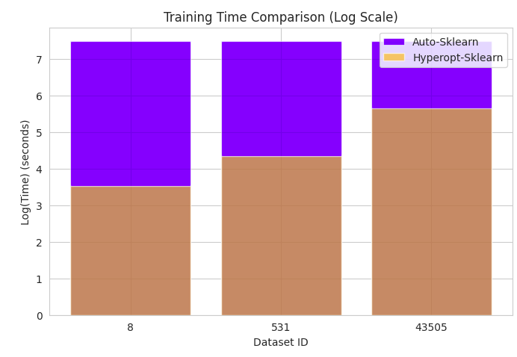
First Part Work: Training Time Analysis
Training Time Trends
Training times vary across datasets, displayed on a log scale for better visualization.
Dataset-Wise Analysis
Auto-Sklearn consistently takes longer than Hyperopt-Sklearn across all datasets.
43505 (Life Expectancy) dataset has the highest training time, especially for Auto-Sklearn.
8 (Liver Disorders) and 531 (Boston Housing) have relatively similar training times.
Model Comparison
Hyperopt-Sklearn is more computationally efficient, requiring significantly less time.
Auto-Sklearn’s longer training time may be due to more extensive hyperparameter tuning.

Slide 10
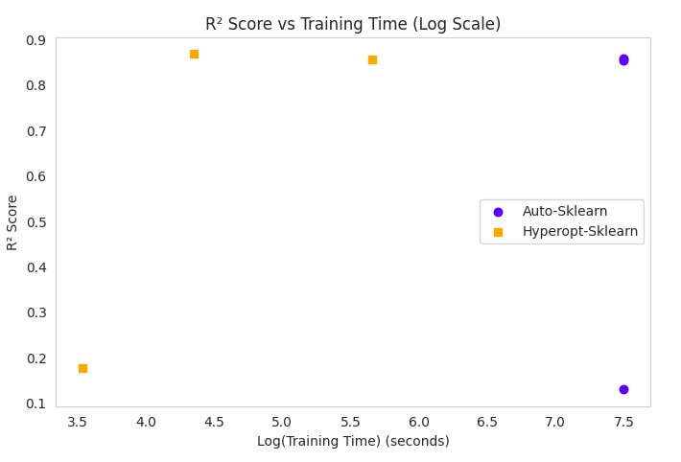
First Part Work: R2 Score vs Training Time Analysis
Training Time vs Performance
Auto-Sklearn generally takes more time but achieves higher R² scores in some cases.
Hyperopt-Sklearn is faster but exhibits slightly lower performance.
Efficiency Trade-off
Hyperopt-Sklearn is computationally efficient, making it a better choice for time-sensitive applications.
Auto-Sklearn shows more variability in R² scores, indicating that tuning complexity impacts performance.
Dataset Dependence
The variation in R² scores suggests dataset characteristics heavily influence model effectiveness.
No clear correlation between training time and R²—higher computation does not always yield better results.

Slide 11
Comments
• Include Auto-WEKA for a more comprehensive baseline.
• Reproduce key experimental plots from the original paper.
• Extend evaluation to novel settings such as multi-label and multi-output regression.
• Explore custom surrogate and acquisition functions using SMAC.

Slide 12
Addressal of Comments
• Implemented Auto-WEKA and ran it on the same datasets.
• Reproduced average ranking plots and performance-over-time plots.
• Conducted experiments for multi-label and multi-output regression using modified Auto-Sklearn.
• Modified SMAC to test different surrogates and acquisition functions.

Slide 13
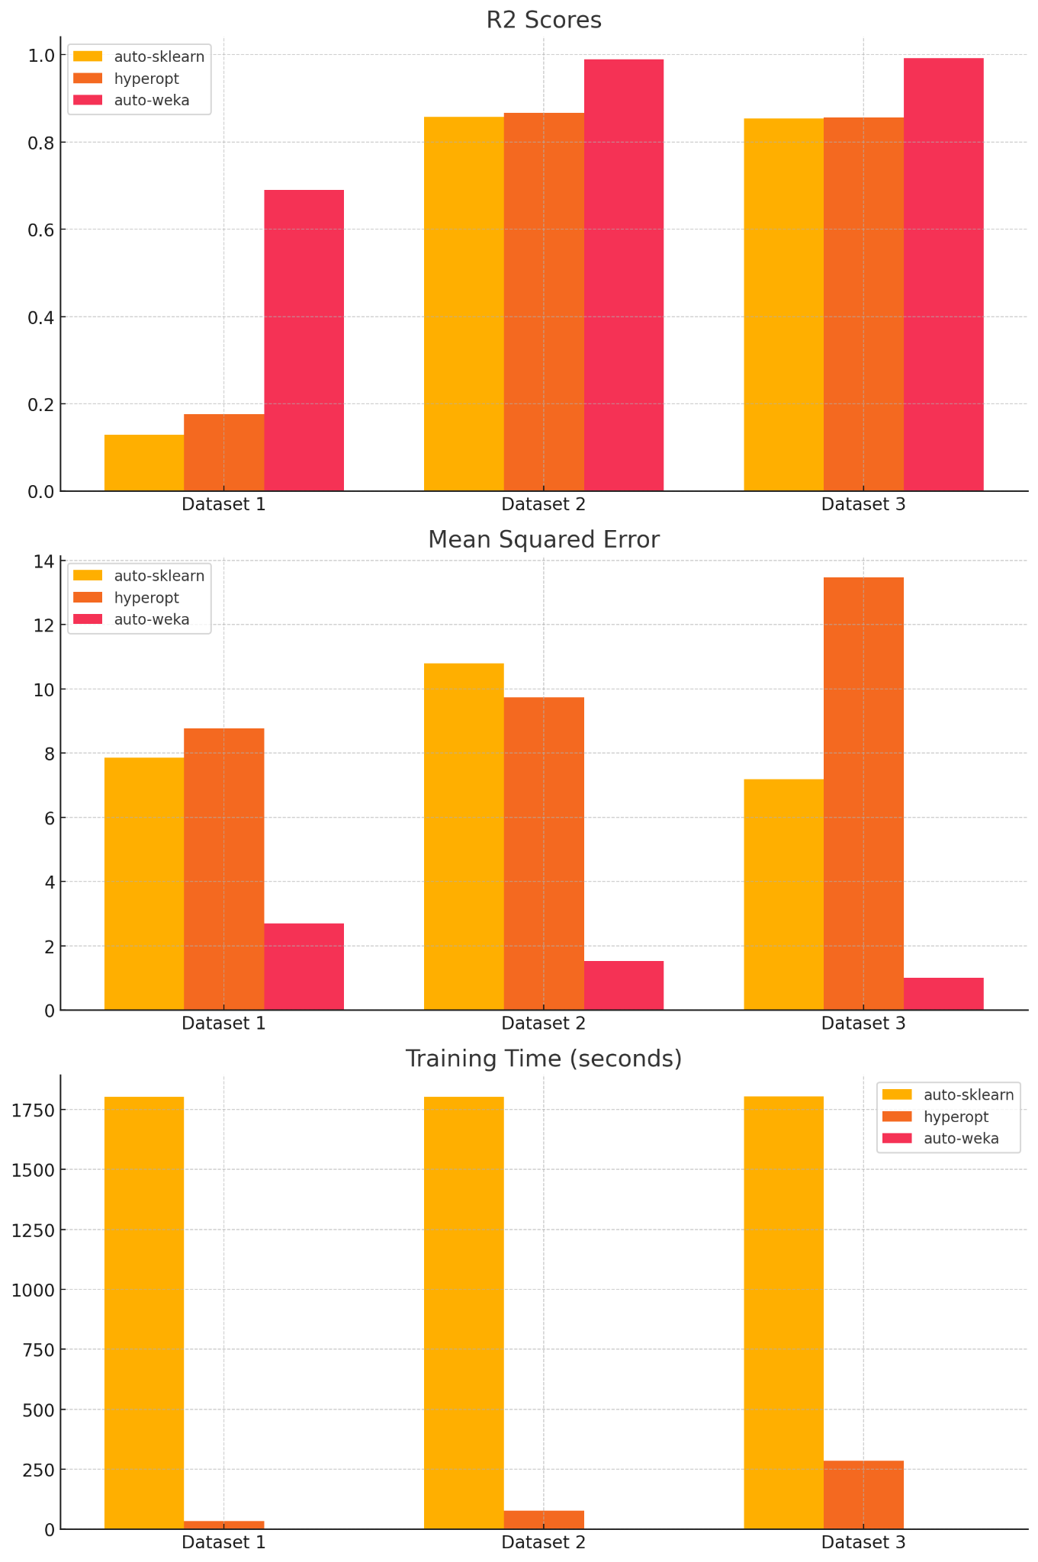
Exp1 : Auto Weka vs Auto Sklearn vs Hyperopt
Dataset 1: Auto-WEKA performs best in R²; Auto-Sklearn lags due to possibly noisy/complex patterns.
Dataset 2 & 3: Auto-Sklearn and Auto-WEKA achieve comparable top performance in R².
MSE Trends: Auto-Sklearn generally achieves lower MSE except on Dataset 3, where Hyperopt performs worse.
Training Time: Auto-Sklearn has significantly longer runtimes (≈1800s), while Auto-WEKA and Hyperopt complete faster.
Trade-off Insight: Auto-Sklearn offers better generalization but is resource-intensive.

Slide 14
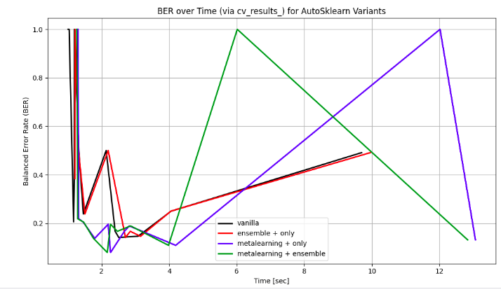
Exp2 :BER over Time for Auto-Sklearn Variants
Meta-learning + Ensemble (green) achieves the best and fastest BER convergence.
Ensemble-only (red) performs better than Vanilla (black), but slower than Meta+Ensemble.
Meta-learning-only (blue) suffers from instability after initial gains.
Confirms the benefit of combining both prior knowledge and model aggregation.
Replicates insights from Feurer et al. (2015).

Slide 15
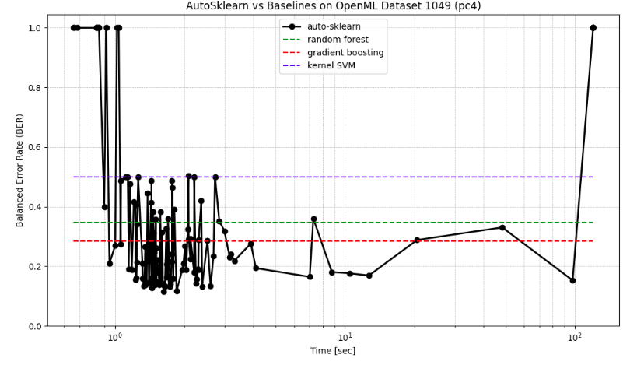
Exp3: Auto Sklearn vs Baseline
Baseline BER levels: SVM (≈0.5), RF (≈0.35), GB (≈0.28).
Auto-Sklearn quickly beats all baselines in under 10 seconds.
BER stabilizes around ≈0.15, showing strong generalization.
Meta-learning warm-starts and ensemble blending drive early performance.
Demonstrates AutoML's strength over fixed single-model pipelines.

Slide 16
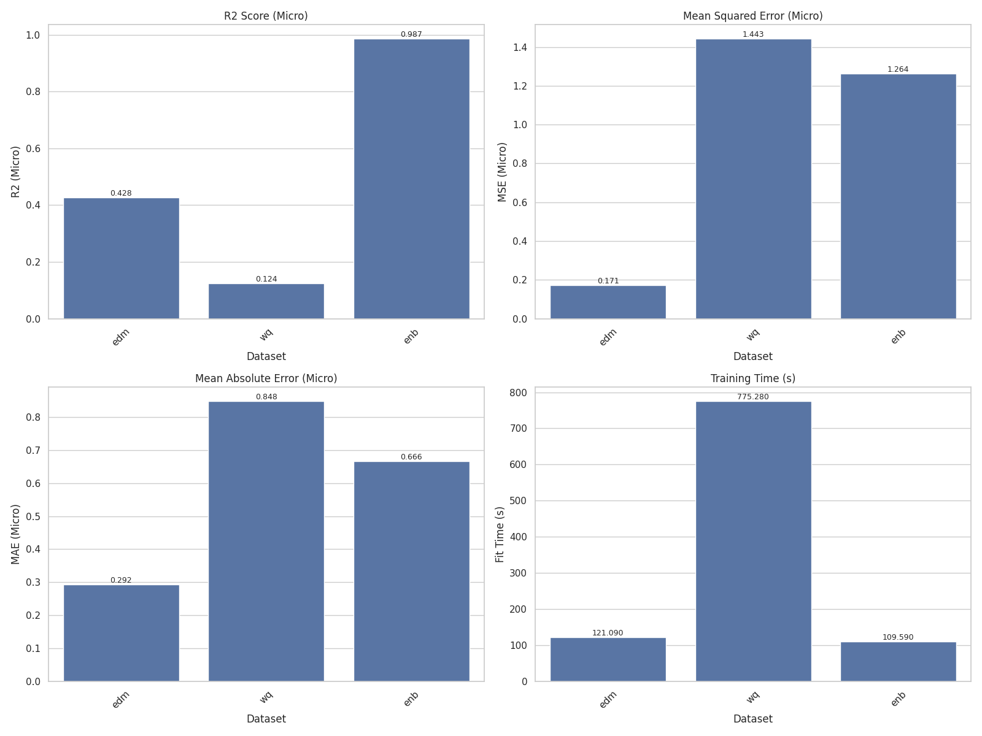
Novelty 1.1 Overall Micro-Metrics of Multi-Label Classification
Genbase leads across all metrics, showing high label separability and dataset quality.
Reuters performs well in accuracy and precision but slightly drops in recall and F1.
Yeast shows lowest performance across all metrics, indicating difficulty due to label imbalance and overlapping features.
Highlights that Auto-Sklearn adapts better to clean, structured datasets (Genbase > Reuters > Yeast).

Slide 17
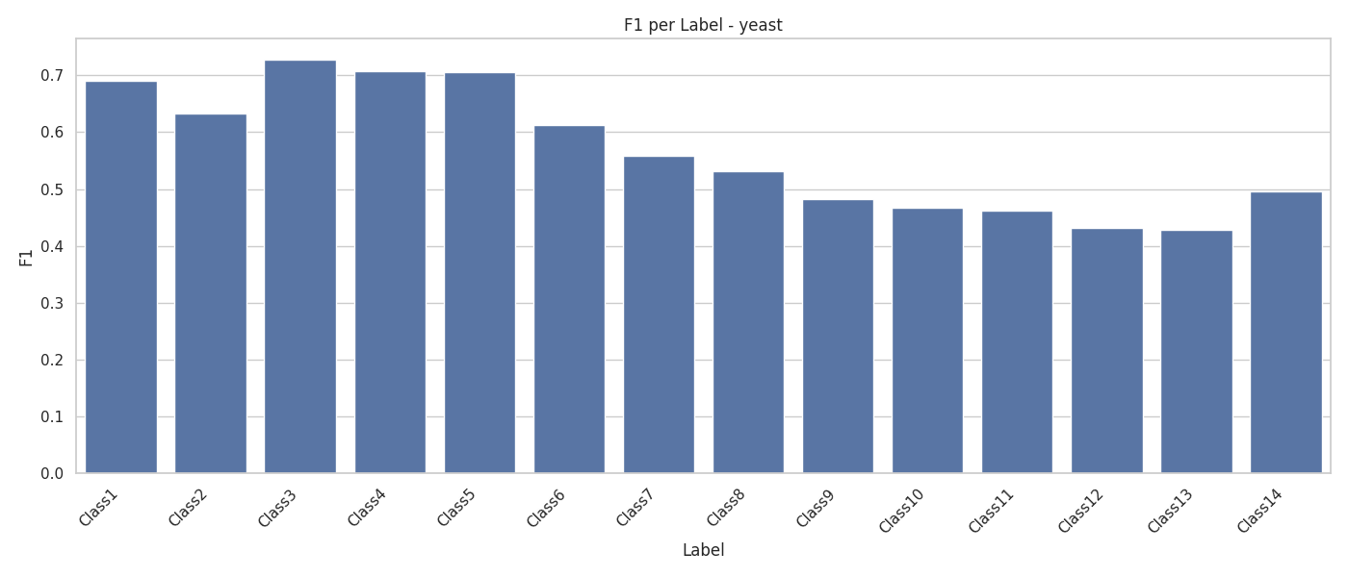
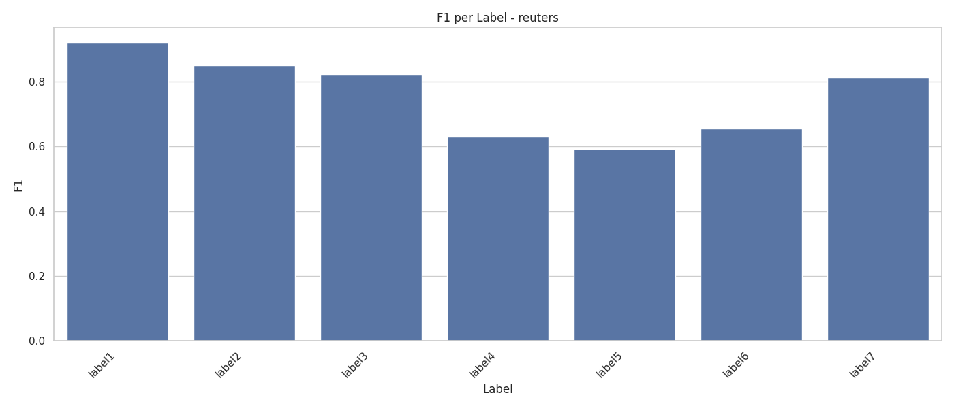
Novelty 1.1 Per-Label F1 Scores of Multi-Label Classification
Yeast:
Classes 3–5 perform best (F1 ~0.70–0.73), indicating clear structure.
Performance drops for Classes 12–14 (F1 ~0.42–0.45), likely due to sparse instances.
Reuters:
Labels 1–3 show strong F1 (0.82–0.93); label 5 is notably weaker (~0.59).
Variability suggests that class frequency and semantic overlap impact per-label results.
Takeaway: Even in strong-performing datasets, certain classes may still require targeted strategies.

Slide 18
Novelty 1.2 : Overall Multi-Output Metrics of Multi Output Regression
R² Score: E8B ≈ 0.987 (best), WQ ≈ 0.124 (worst), EDFM moderate.
MSE and MAE: Corroborate R² rankings; WQ shows highest error.
Training Time: WQ is slowest (~775s), possibly due to noisy features or long pipelines.
Takeaway: Auto-Sklearn adapts best to well-structured multi-output datasets (like E8B).
Dataset-dependent behavior emphasizes the need for meta-feature-aware tuning.

Slide 19
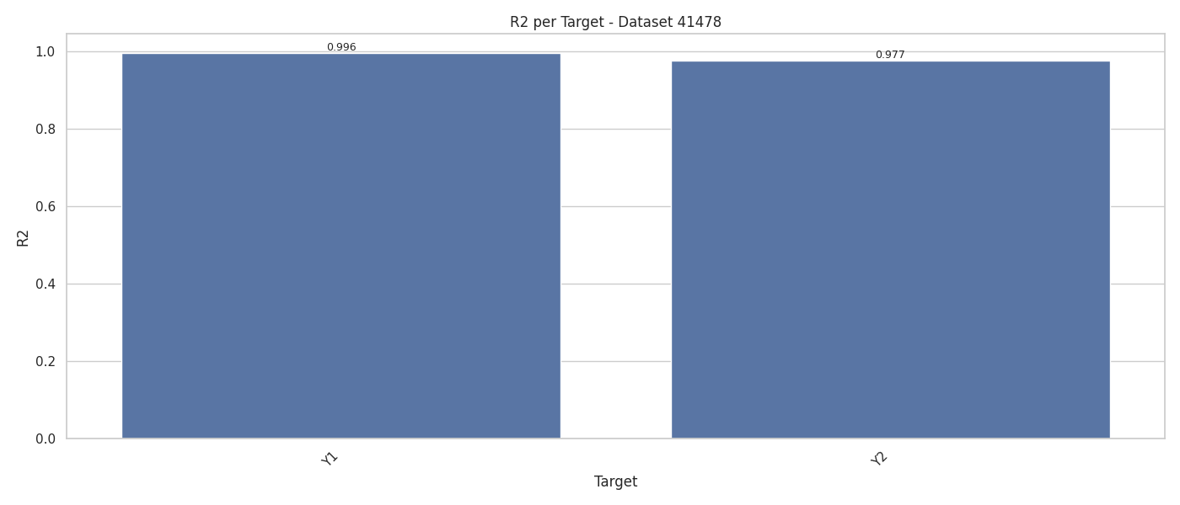
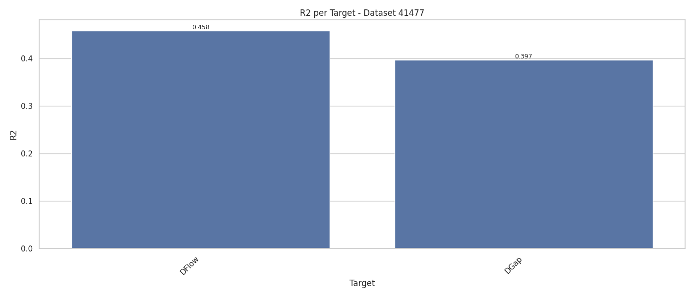
Novelty 1.2 Target-wise R² – Multi-Output Regression
Dataset 41478:
Target y1: R² = 0.996, Target y2: R² = 0.977
Auto-Sklearn achieves near-perfect fit, indicating low noise and high predictability.
Suitable benchmark for validating multi-output regression capacity.
Dataset 41477:
Target DFlow: R² = 0.458, Target DGap: R² = 0.397
Significantly lower scores suggest complex target dependencies and noisier features.
Demonstrates the AutoML pipeline’s limitations on harder structured prediction tasks.
Key Insight:
Performance varies greatly by dataset — emphasizing the need for data-aware tuning strategies in AutoML.

Slide 20
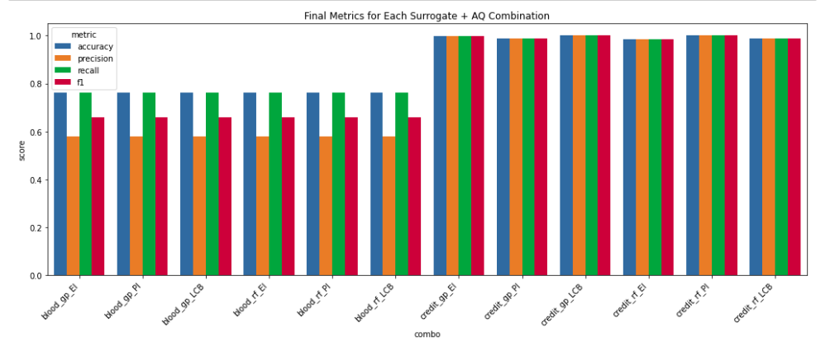
Novelty 2 :Final Metrics for All SMAC Variants
Accuracy, precision, recall, and F1 were computed for 6 combinations on 2 datasets.
Credit-G: RF + EI and RF + PI yield near-perfect classification across all metrics.
Blood: All metrics lower due to imbalance, with RF + EI still outperforming others.
GP-based surrogates underperform on Blood dataset due to overfitting or noise sensitivity.
EI and PI acquisition functions balance exploration-exploitation effectively; LCB remains too conservative.

Slide 21
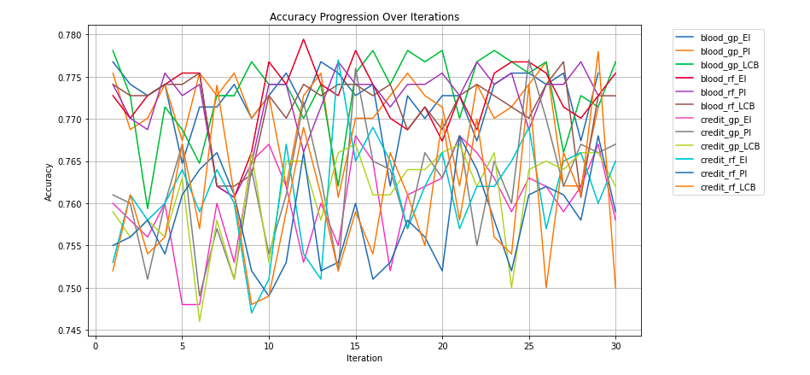
Novelty 2 :Convergence Trends of Surrogate + Acquisition Combos
RF+EI and RF+PI combos show early and stable convergence (~15–20 iterations).
GP-based models have more erratic behavior due to less stability on categorical data.
Blood dataset shows larger variance in performance due to class imbalance.
Credit-G shows tighter clustering, indicating better learnability and smoother optimization surface.
LCB-based methods tend to under-explore, leading to suboptimal plateauing.

Slide 22
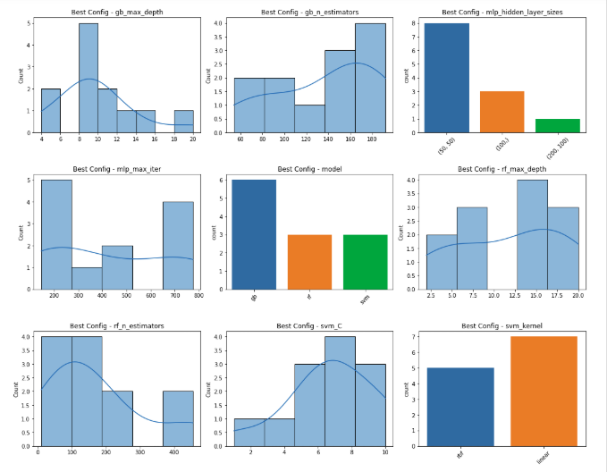
Novelty 2 :Best Configuration Insights Across Models
Histograms represent distribution of optimal hyperparameters across GB, MLP, RF, and SVM.
RF and GB prefer higher estimator counts, supporting ensemble diversity.
MLP configurations show preference for shallow architectures (e.g., (50,50)), reducing overfitting risk.
SVM models consistently favor the RBF kernel, with C values centered around 6–10.
RF and GB max-depths skew lower, showing that shallow trees generalize better under time constraints.

Slide 23
Contribution
Sai Madhav : Multi Label Classification, Auto Weka and Hyperopt
Trivikram : Auto Sklearn vs Benchmark, Variations of Auto Sklearn, Multi Output Regression, Custom Made SMAC

Slide 24
Conclusion
Auto-Sklearn consistently outperformed Auto-WEKA and Hyperopt on most tasks, though at the cost of longer training times.
Meta-learning and ensemble construction significantly improved early convergence and generalization.
Extensions to multi-label and multi-output regression demonstrated the adaptability of Auto-Sklearn with wrapper-based augmentation.
Novel SMAC experiments showed that surrogate model and acquisition function choices strongly influence performance and stability.
Dataset complexity and structure had a clear impact on AutoML effectiveness, reaffirming the need for tailored strategies.

Slide 25
Future Directions
Explore deep-learning-enabled AutoML frameworks like AutoKeras or H2O-AutoML for comparison.
Extend multi-label support with label correlation modeling (e.g., classifier chains).
Integrate dynamic ensemble pruning to improve runtime without sacrificing accuracy.
Develop a meta-feature-based selection mechanism for warm-starting configuration on unseen datasets.
Evaluate performance on time-series, text, or real-world industrial datasets to generalize conclusions.

Slide 26
References
Feurer, M., Klein, A., Eggensperger, K., Springenberg, J., Blum, M. and Hutter, F., Efficient and robust automated machine learning. Advances in neural information processing systems, 2015 link
Brazdil, Pavel, Christophe Giraud Carrier, Carlos Soares, and Ricardo Vilalta. Metalearning: Applications to data mining. Springer science & business media, 2008. link
J. Snoek, H. Larochelle, and R. P. Adams. Practical Bayesian optimization of machine learning algorithms. In Proc. of NIPS’12, 2012. link
M. Feurer, J. Springenberg, and F. Hutter. Initializing Bayesian hyperparameter optimization via meta learning. In Proc. of AAAI’15, 2015. link
https://www.openml.org/ Accessed on: 19th March 2025
Komer, Brent, James Bergstra, and Chris Eliasmith. Hyperopt-Sklearn: Automatic Hyperparameter Configuration for Scikit-Learn. In Scipy, 2014. link
Thornton, Chris, Frank Hutter, Holger H. Hoos, and Kevin Leyton-Brown. Auto-WEKA: Combined selection and hyperparameter optimization of classification algorithms. In Proceedings of the 19th ACM SIGKDD international conference on Knowledge discovery and data mining, 2013. link
Brochu, Eric, Vlad M. Cora, and Nando De Freitas. A tutorial on Bayesian optimization of expensive cost functions, with application to active user modeling and hierarchical reinforcement learning. arXiv preprint arXiv:1012.2599, 2010. link

Slide 27
AI tools
ChatGPT
Perplexity

Slide 28
Thank You!

